Slide 1
Course Introduction
Lecture #00
SE271 Object-Oriented Programming (2020)
Yeseong Kim
Original slides from Prof. Shin at DGIST
Notes:
첫 시간
강사 소개

Slide 2
Overview for Today
Course Introduction
Course Information
Objectives
Schedule
Class Policy
Very Short Introduction to OOP and C++
Notes:
시험과 무관하지만 중요

Slide 3
Course Information
Instructor: 김예성
Email: yeseongkim@dgist.ac.kr
Office: E3-613
In-person meeting available in very special cases
LMS
Notice
Q&A
Scores
Homework (tentative)
TA
임준수 (junsu@dgist.ac.kr)
(Unofficial but very useful) Textbook
C++
Learn C++
Teach yourself C++ 시리즈
OOP Design
Design pattern
Google!

Slide 4
Course Information
Office Hour
Mon. 12:00~13:00, i.e., right after the class
(If you need another time, please email me for an appointment)
Happen in Zoom
I will post the link in LMS
Due to the large volume of the class, please utilize Q&A in LMS for short questions!
TA Office Hour: Wed. 12:00~13:00
Utilize the tutoring service as well!
Will use Piazza – the link will be available in LMS

Slide 5
This Course for
(Most likely) Sophomore
Have programming experience
(assumed) know basic programming concepts incl. control flow, function, variables…
(Many of you) want to learn advanced programming
Be interactive!
Notes:
C해본사람?
C++해본사람?
Java해본사람?
아무것도 안해본사람?
전공자?

Slide 6
Objectives
What do you expect to learn?
In this course,
Essential grammar of C++
Object-Oriented Programming Concepts (Not Objected-Oriented)
Design and implement the programming based on OOP
Will not cover
Basic Programming
Complete grammar of C++
GUI, system program, …
How to use IDE tools (incl. debugger)
Advanced Design, e.g., UML
Notes:
수업에서 얻고자하는것이 무었인가?
이코스는 약간 전공자 위주? – 기초를 가르치지 않는다.
그럼 뭐를 하는가?
C++에 기반하지만…….원래는…OOP
OOP에 적합한 언어는 JAVA? Smalltalk
여러분들이 잘 공부하셔야함….

Slide 7
Tentative Schedule
Week | Contents | H/W
1 | Course Introduction Hello World!!
 | Variable, Array, basic operator, Comment, Type casting, scope
2 | Flow Control
 | Pointer
3 | Reference type
 | Function (return type, parameters(call by xx), inline) | #1
4 | Class (constructor, destructor, vs. Struct)
 | Class (protected, private, public, static method )
5 | Polymorphism 1 | #2
 | 추석 휴일
6 | Polymorphism 2
 | Polymorphism 3
7 | Template 1 | #3
 | Template 2
8 | Midterm Exam
Week | Contents | H/W
9 | Inheritance 1
 | Inheritance 2
10 | Virtual function – final(c11)
 | Stream | #4
11 | STL
 | STL
12 | Exception Handling
 | Object-oriented Design
13 | Object-oriented Design
 | UML
14 | Team project (Presentation 1)
 | Team project (Presentation 2)
15 | Course Review
16 | Final Exam
* Schedule is likely to be changed
Notes:
- 실습의 태도 점수…..수행 점수도 반영될 예정임

Slide 8
Assessment
Exams (50%)
Midterm (25%)
Final exam (25%)
Assignments (20%)
4 HWs (5% each)
Late submits : 50% penalty per a day
Term project(30%)
3~4 students per a team
Absence penalty
2^{max(n - 2, 0)} – 1
Scores | Grade
100 ~ 85 | A
84 ~ 70 | B
69 ~ 50 | C
50 ~ 0 | D
** 부정행위는 F 처리할 예정임
Notes:
약간 변경가능
숙제는 자주 많이 나옴 -= 절대 베끼지 말것…난잉도는 조절할 예정

Slide 9
Homework Information
Will use an automated grading tool
Don’t try to cheat in any ways
Spend your time to understand and implement it by yourself
Rule of Grace Submission
Working condition: When your submission fails to be compiled
What to do: Submit an edited version with a report what you change
# of Grace(s): Once over four homework(s)
* Details will be announced later.

Slide 10
Term Project
Team Project
Team project
Any DGIST-related topic chosen by each team
A team consists of 3~4 students
What you will do
Proposal (1 A4 page, font size 12)
In-class Presentation
Requirements, Class design, etc.
Implementation
* Details will be announced later.
Notes:
- 주제가 없으면, 본인 과에서 사용하는 각종 시뮬레이션. – 합성, 수식, 입자 출동, 실생활인 (자재관리)도서관 자리예약/대출, 강의실 출석 체크, 성적 관리, 임금 시스템,

Slide 11
Very Short Introduction to Object-Oriented Programming
One of popular programming paradigms
Will learn following concepts about Objects
Abstraction
Encapsulation
Inheritance
Polymorphism
cf. Procedural programming (C style)
Notes:
절차지향….결국 함수를 이용하는 순차적 진행 – c++는 안그런가?
객체와 관계로

Slide 12
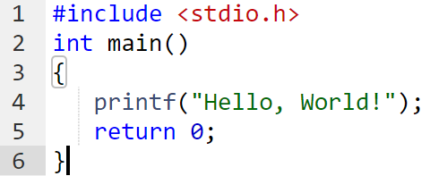
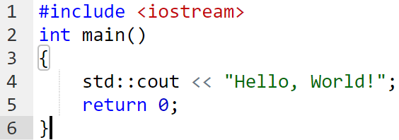
Short Introduction to C++
C++ == C ?
C++ is a superset of C?
Notes:
연산적 사고
프로그래밍 기술

Slide 13
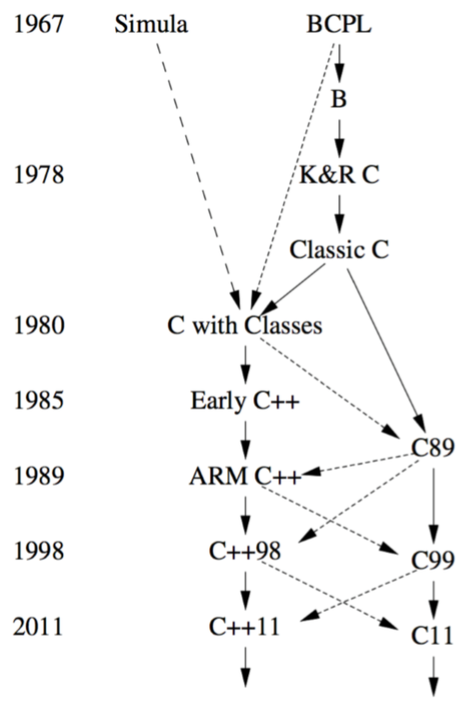
History of C/C++
1970 Kernighamand Ritchie invents C(K&R C)
1980 Bjarne Stroustrup creates "C with classes"
1983 "C with classes" is renamed as "C++"
1989 The C standard is ratified (ANSI C, C89)
1995 The ANSI committee releases a draft of the C++ standard
1998 An official C++ standard is adopted(C++98)
C++ influenced by C
Procedural programming
Object-oriented programming
Generic Programming

Slide 14
TIOBE index
순위 | TIOBE Index (Aug. 2020) | Top programming languages on github (Apr. 2019) | The top programming languages by IEEE (2018)
1 | C | JavaScript | Python
2 | Java | Java | C++
3 | Python | Python | Java
4 | C++ | PHP | C
5 | C# | C++ | C#
6 | Visual basic .Net | C# | PHP
7 | JavaScript | TypeScript | R
8 | R |  | JavaScript
9 | PHP |  | Go
10 | SQL |  | Assembly
출처: TIOBE index, github, IEEE spectrum

Slide 15
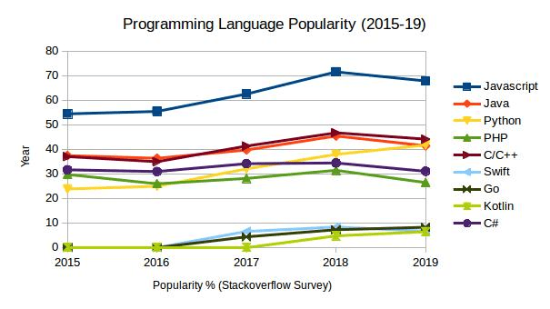
PL Popularity
Image Source: codinginfinite

Slide 16
Why C++?
Popularity
one of the largest code base
Performance
the main development language for many system/ applications that require good performance
Flexibility
low-level to high-level
Productivity
libraries and development tool support

Slide 17
C++ Compiling Process
프로그래밍 교과 소개 및 목적
Source Code
Source Code 2
Source Code 3
Runtime, Libs
Preprocessor
Compiler
Linker
Temporary file
Object
File
Executable File
Temporary file
Object
File
Temporary file
Object
File
Notes:
Machine code

Slide 18
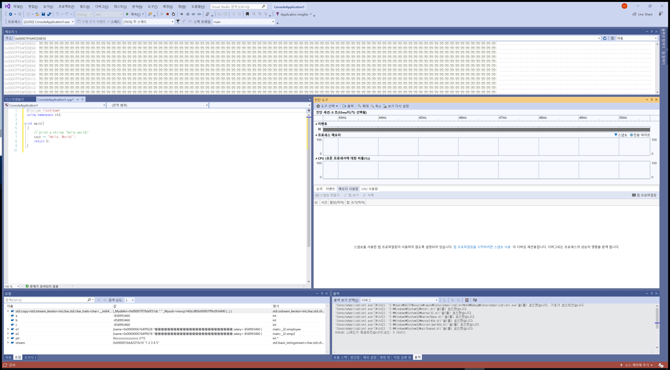
IDE (Integrated Development Environment)
Ex.)
Windows : MS Visual Studio, Editplus, …
Linux : g++ + vim, notepad++, …
macOS : Xcode, …
(for this class, VS 2019 community version?

Slide 19
예제: Hello World!
/* 예제 파일 */
#include <iostream>
using namespace std;
int main()
{
int num1, num2;
num1 = 1; num2 = 2;
// print a string 'hello world!'
std::cout << "Hello, World!" << endl;
cout << num1 <<"+"<< num2 <<"="<< num1+num2;
return 0;
}
Hello, World!
1+2=3

Slide 20
ANY QUESTIONS?

